Slide 1
SA deep dive
Preliminary findings from a Market Power Perspective

Slide 2
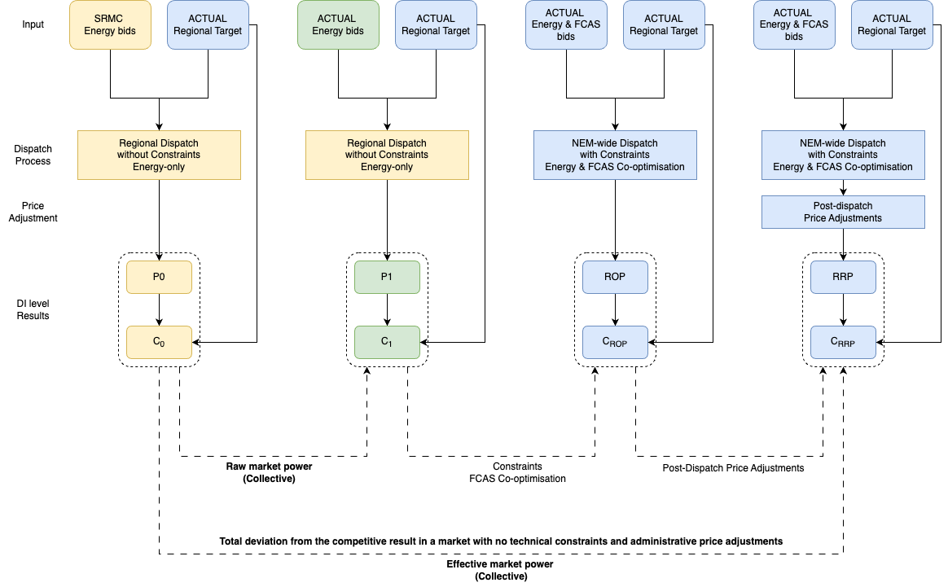
Regional collective market power - Method
P0 stands for the simulated RRP assuming all generators bid at SRMC in the spot energy market. (Batteries and Hydro bid at $0/MWh at their actual dispatch targets)
P1 stands for the simulated RRP assuming all generators bid at their actual bids in the spot energy market.
RRP stands for the actual regional dispatch cost provides by AEMO.
Cost stands for the corresponding regional dispatch cost.
Raw market power = Cost_P1 – Cost_P0, it represents the tentative regional collective market power level, assuming no system constraints and no FCAS co-optimization.
Effective market power = Cost_RRP – Cost_P0, it represents the realized regional collective market power level, considering the existence of system constraints, FCAS co-optimization and post-dispatch price adjustments (such as Administrative price cap).
Please see “Regional collective market power” section in Estimating regional collective and individual market power (notion.site) for the details regarding regional level estimation.

Slide 3
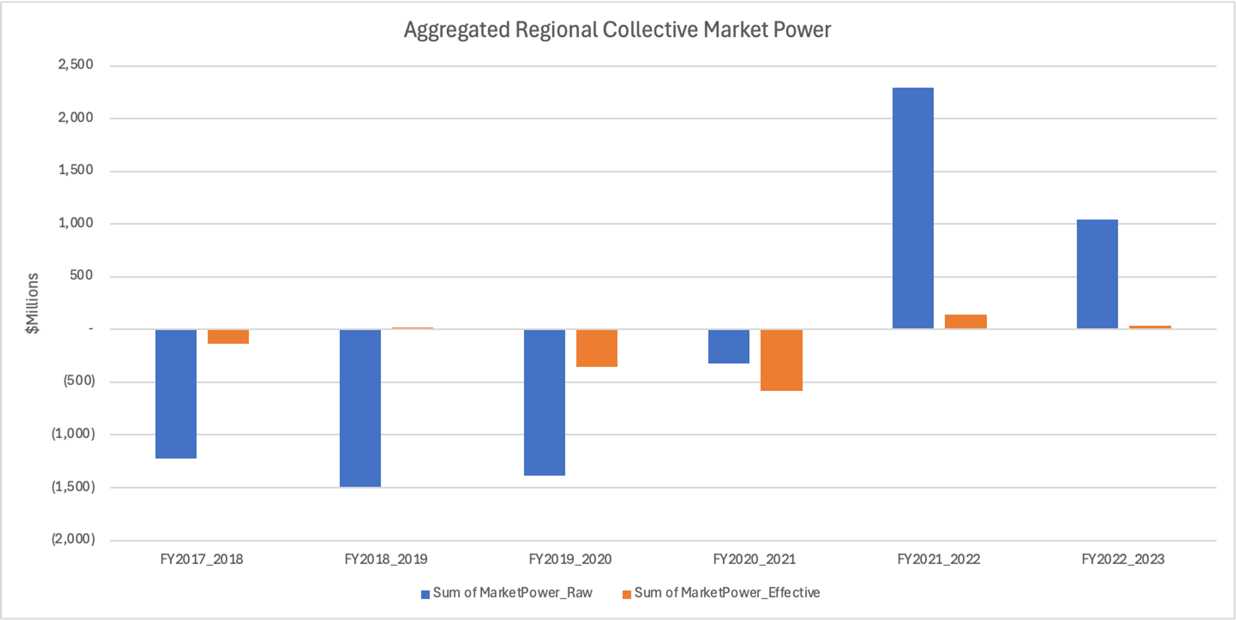
Regional collective market power
Key messages:
At a high level, from FY2017-2018 to FY2020-2021, generators collectively in SA did not show evidence of tentative market power (blue bars).
At a high level, in FY2021-2022 and FY2022-23, generators collectively in SA did try exercising significant market power (blue bars). However, the effect of system constraints, FCAS Co-optimization and post-dispatch price adjustments have lowered dispatch prices hence mitigated the effect of market power. As a result, the effective market power level (orange bars) are quite low.
Please note the tentative collective market power (blue bars) for FY2021-2022 and potentially FY2022-2023 may change to some extent if I use market gas prices instead of ISP gas price for estimation. Will do a parallel analysis soon to demonstrate that.

Slide 4
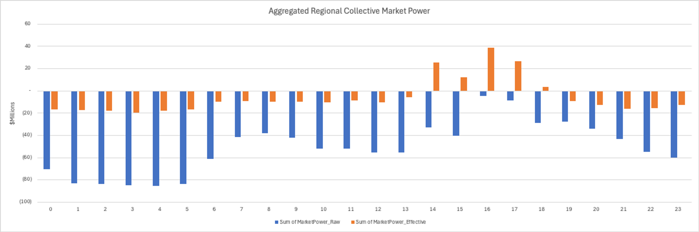
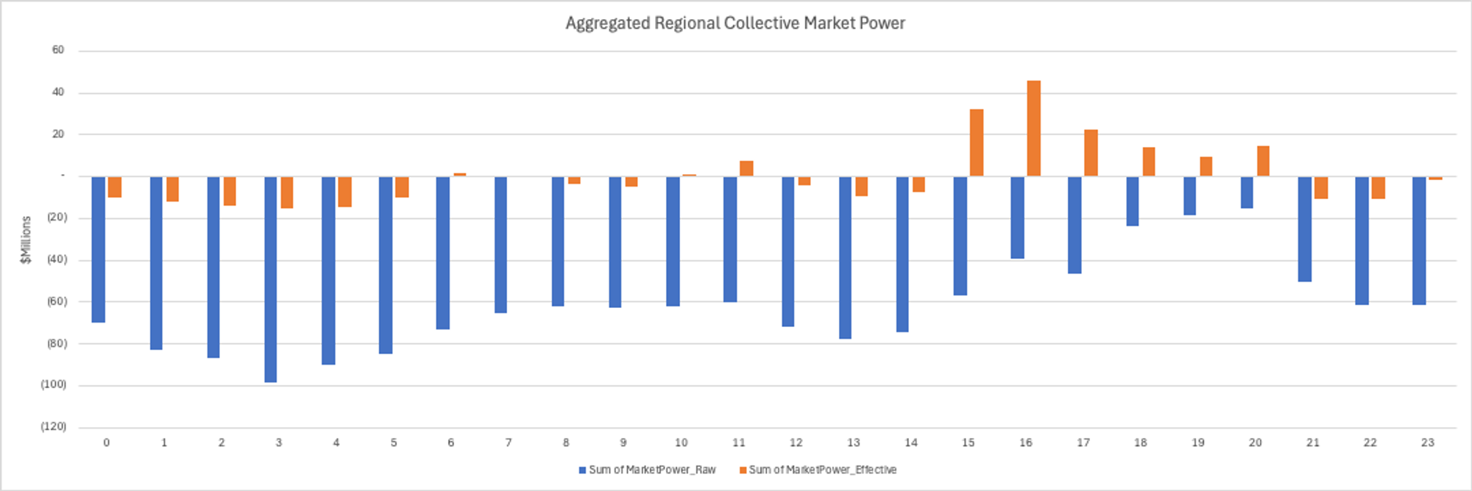
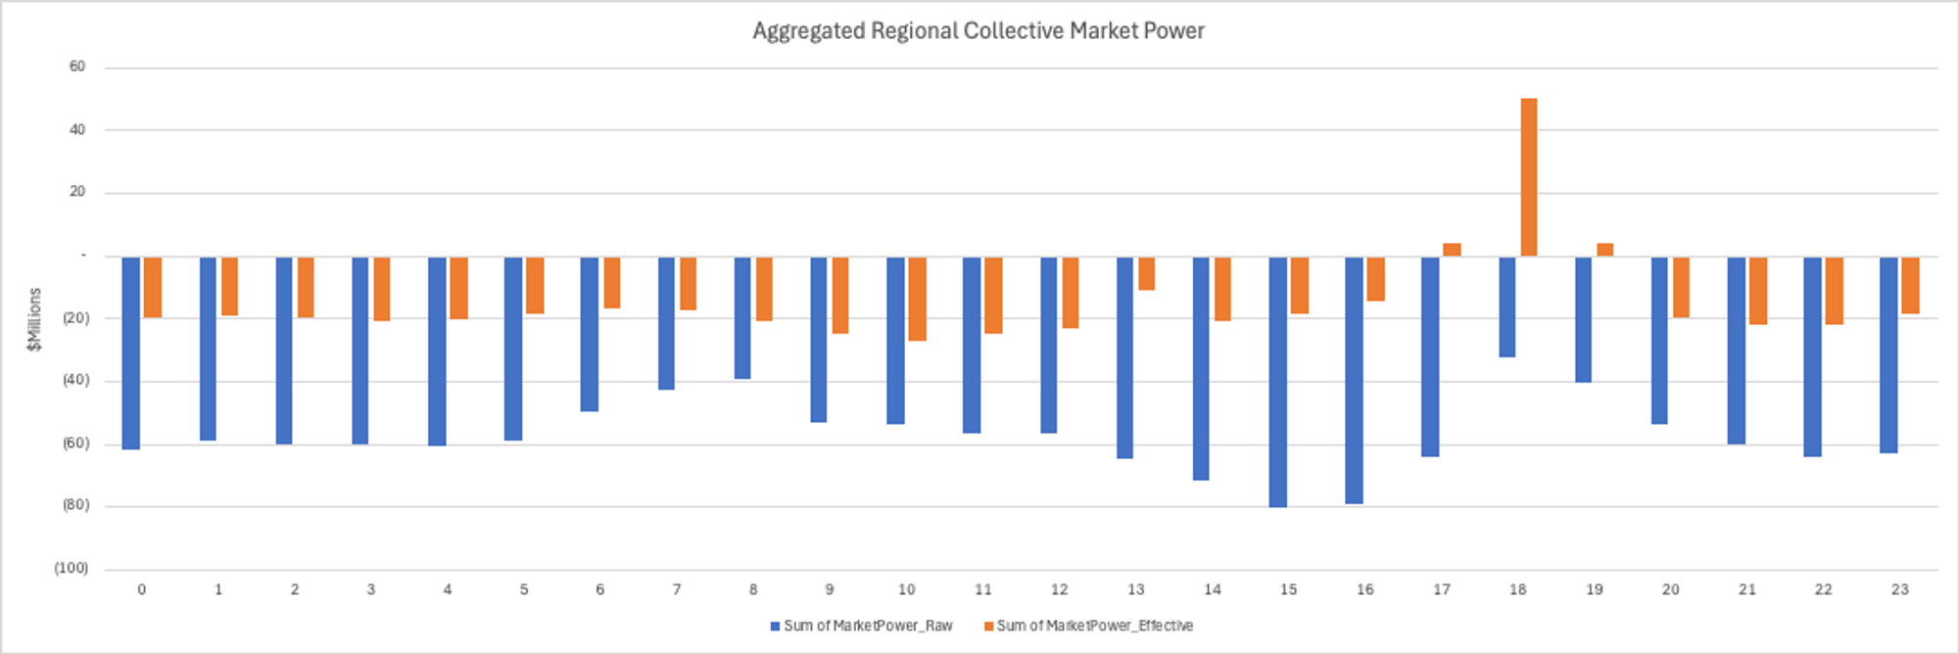
Regional collective market power
FY 2017-2018
Key messages:
At a high level, from FY2017-2018 to FY2020-2021, generators collectively in SA did not show evidence of tentative market power (blue bars).
However, from late afternoon to evening peak, probably mainly due to system constraints that affected the order of dispatch in the bidding stack, the metric shows evidence of effective market power (orange bars).
FY 2018-2019
FY 2019-2020

Slide 5
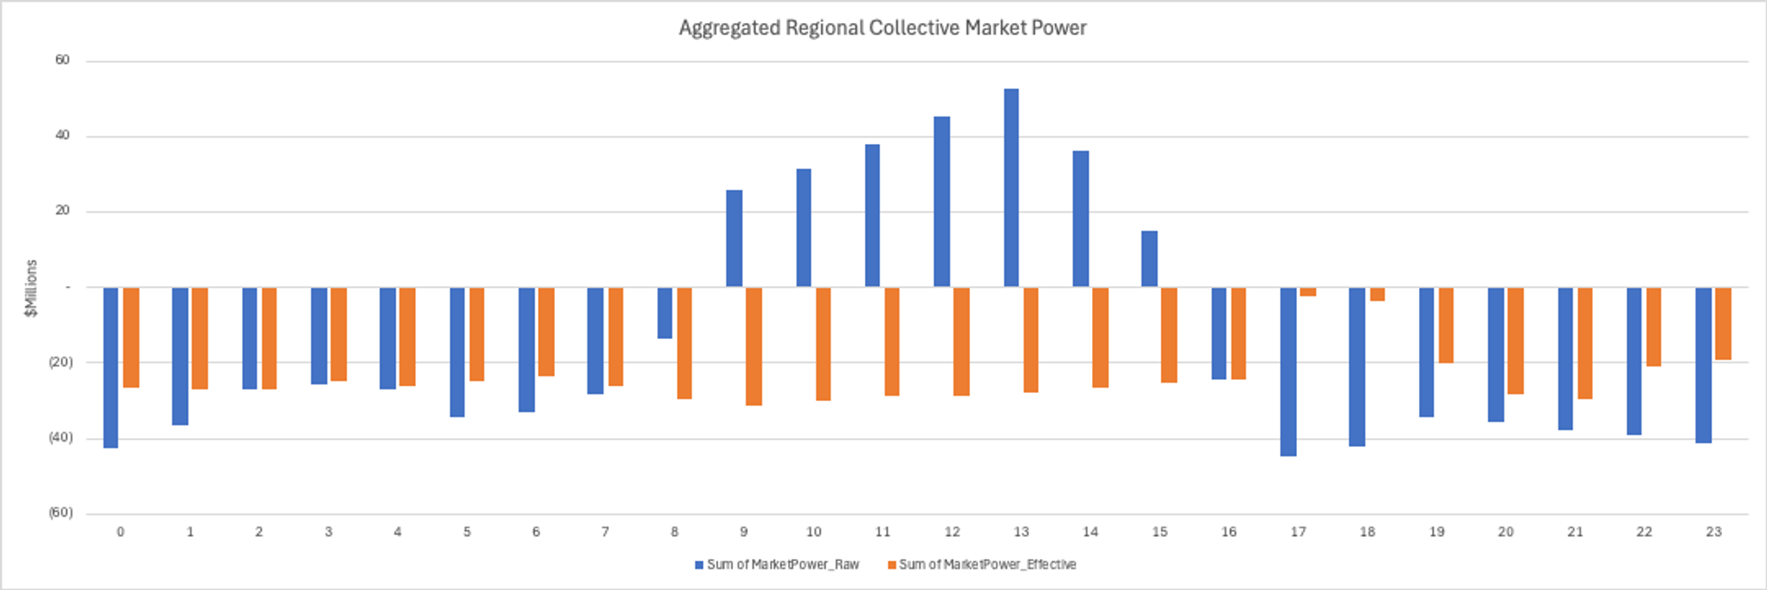
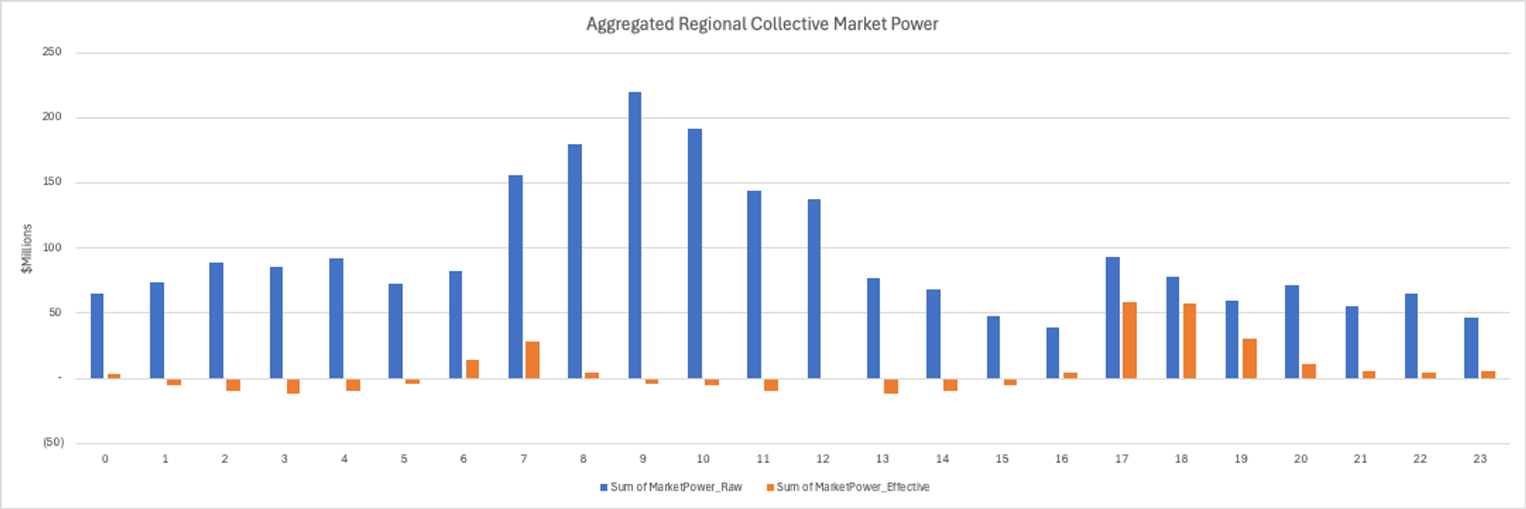
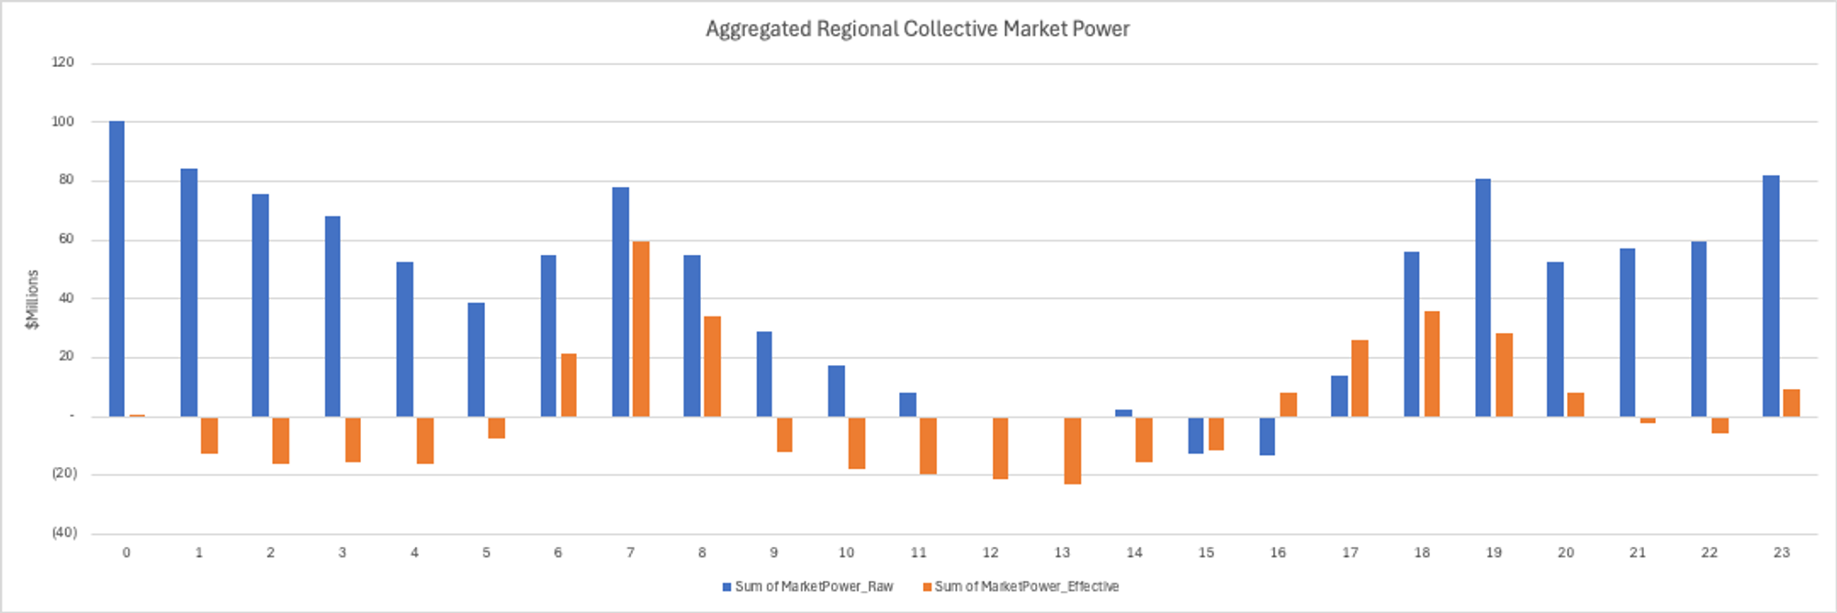
Regional collective market power
FY 2020-2021
Key messages:
At a high level, in FY2020-2021, generators collectively in SA did show evidence of tentative market power around the midday (blue bars). However, probably mainly due to some system constraints (e.g., direct on), the metric indicates that the tentative market power did not get realized (orange bars).
In FY2021-2022 and FY2022-2023, generators collectively in SA did show evidence of tentative market power in most time of the day (blue bars). However, probably mainly due to some system constraints (e.g., direct on), the metric indicates that most tentative market power did not get realized, except during morning and evening peak hours (orange bars).
FY 2021-2022
FY 2022-2023

Slide 6
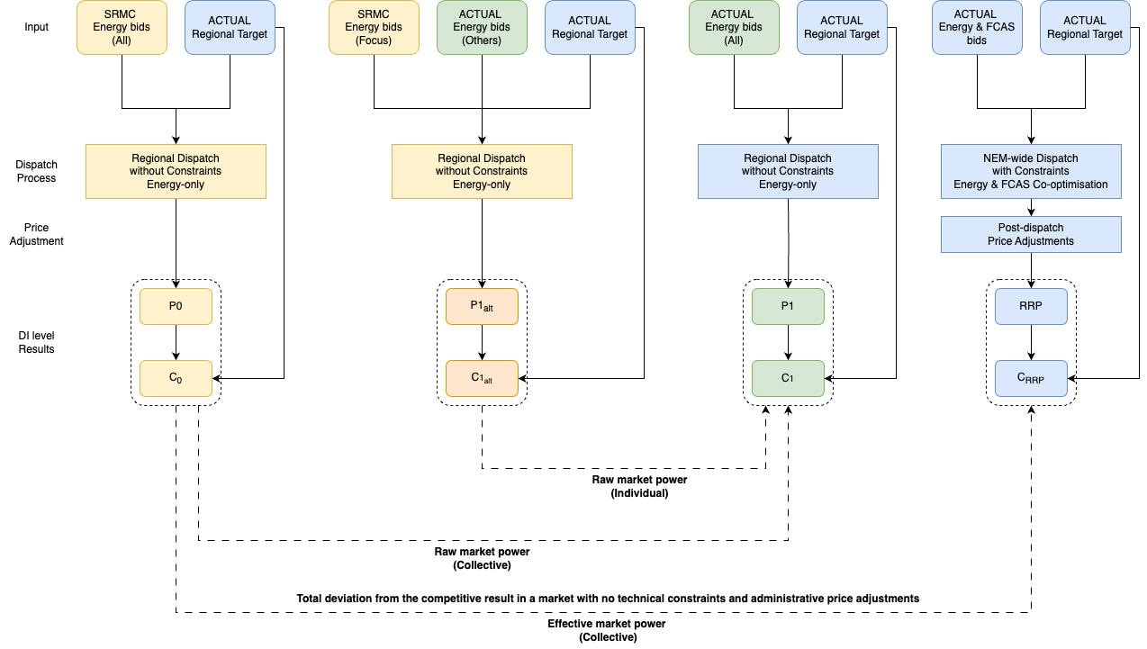
Regional individual market power - Method
P1_alt stands represents the alternative simulated dispatch price that in the P1 scenario:
all other generators bid at actual bids,
while the generator of interest bids at SRMC
Then, the C1 – C1_alt represents the potential impact on the regional dispatch cost, because the generator of interest using its actual energy bid instead of SRMC bid.
This metric is used as a proxy for the potential market power exercised by the generator of interest. However, this potential market may not be realized because of system constraints, FCAS co-optimization and post-dispatch price adjustments.
Please see “Individual raw market power” section in Estimating regional collective and individual market power (notion.site) for the details regarding individual level estimation.
Also, please see Estimating SRMC for Battery and Hydro energy storages (notion.site) for the details regarding SRMC estimation for battery and hydro energy storages.

Slide 7
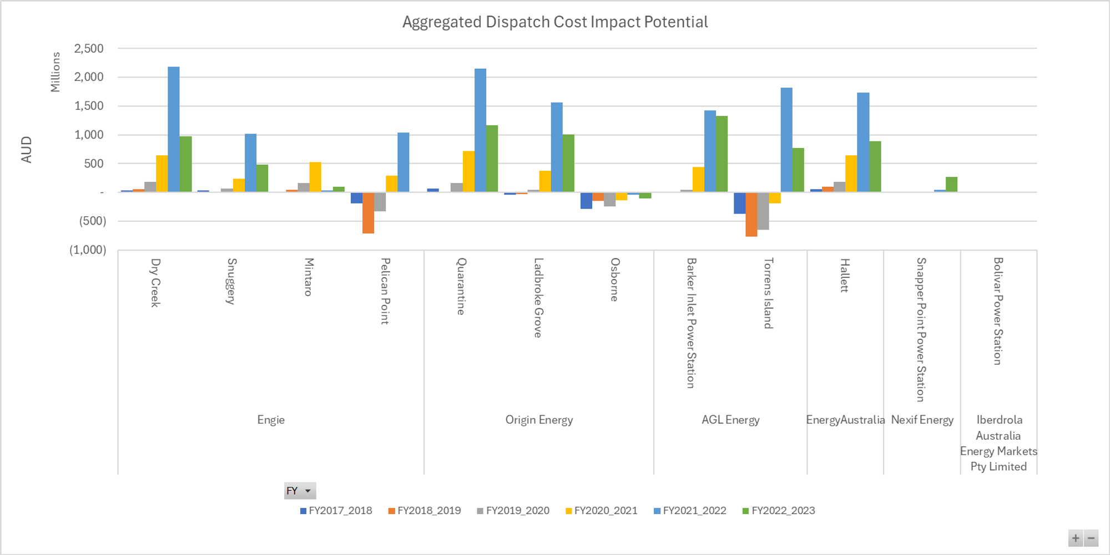
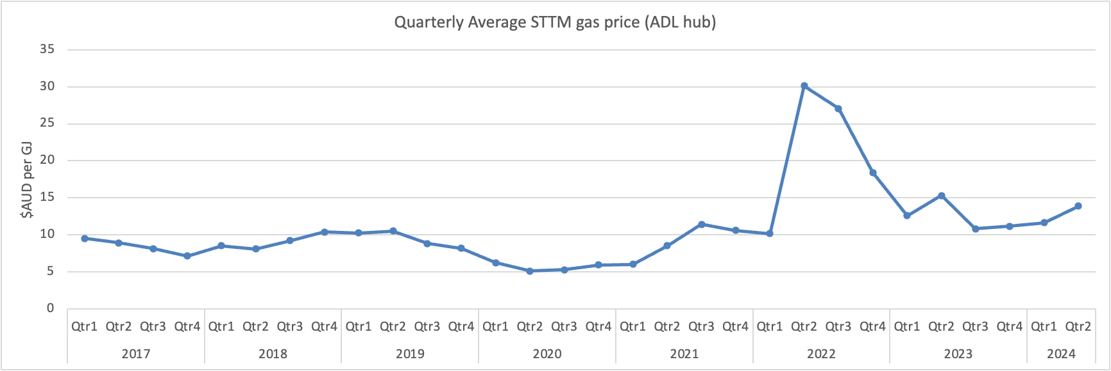
Regional individual potential market power
Key messages:
At a high level, gas generators show little or no evidence trying exercising market power from FY2017-2018 to FY2020-2021.
However, most of them show evidence trying exercising significant market power in FY2021-2022 and some in FY2022-2023.
We saw significant gas price spikes in Q2, Q3 and Q4 2022, and generators’ exposure to such high fuel prices may not be accurately reflected in AEMO’s ISP fuel price estimation.
Will take a parallel simulation using market gas price. The results would help us develop a range of potential market give different level of direct exposure to the fluctuating gas market.
Diesel generators show similar patterns to Gas generators.

Slide 8
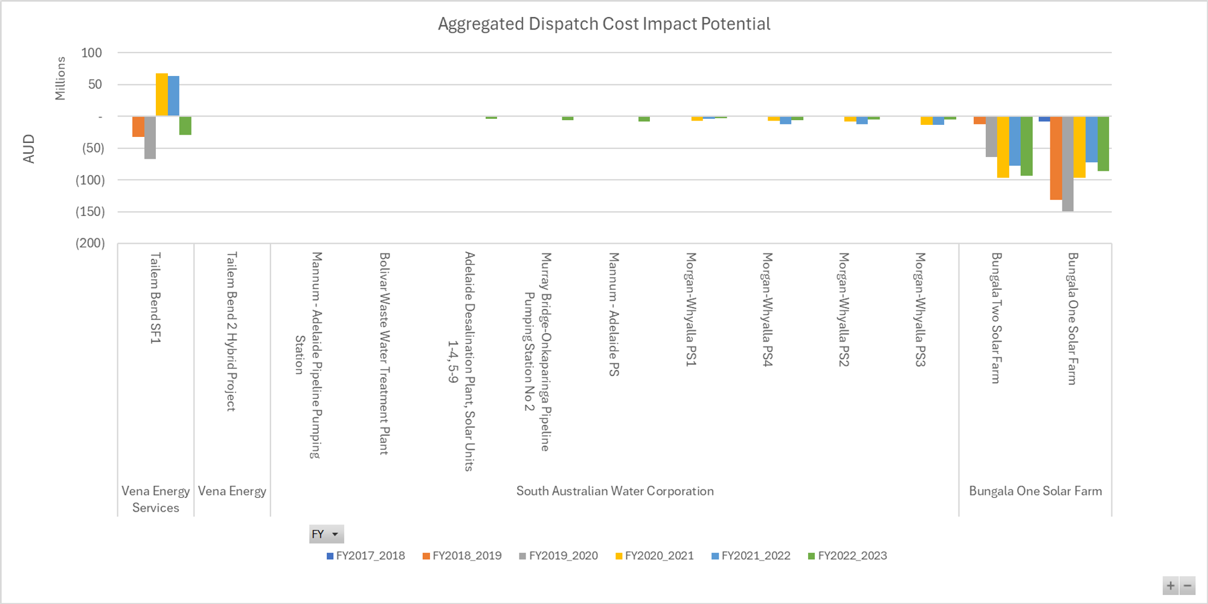
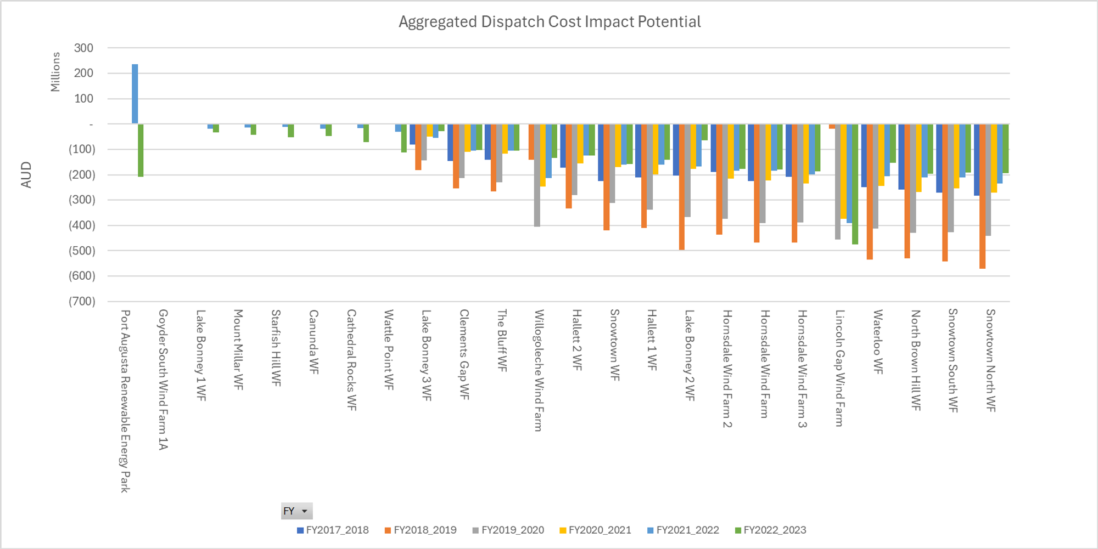
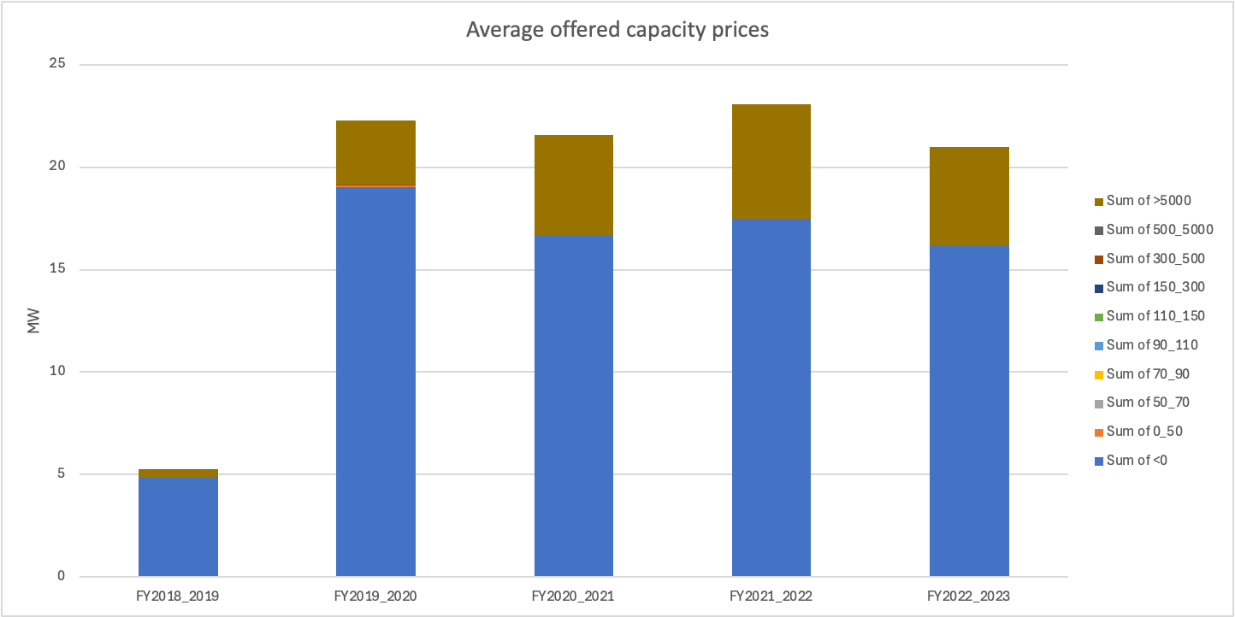
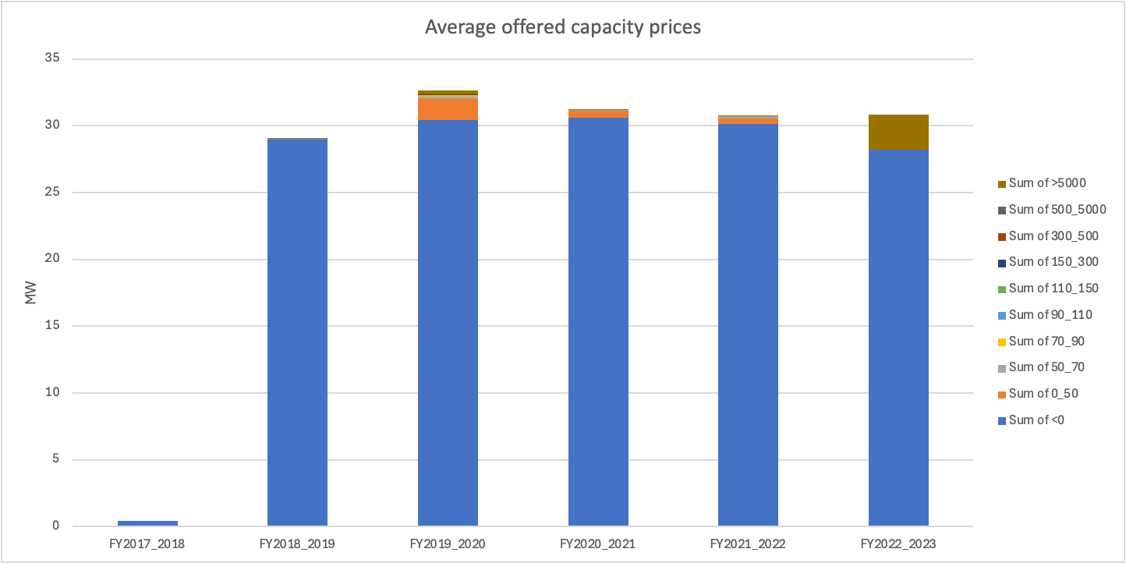
Regional individual potential market power
Solar
Wind
Key messages:
At a high level, most solar and wind generator did not try exercising market power, as they intend to bid most of their capacity at negative prices. The exception is Tailem Bend SF1 (the stand-alone solar farm) which shows evidence trying exercise market power. See the below chart for the comparison between Tailem Bend SF1 (left) and Bungala One.

Slide 9
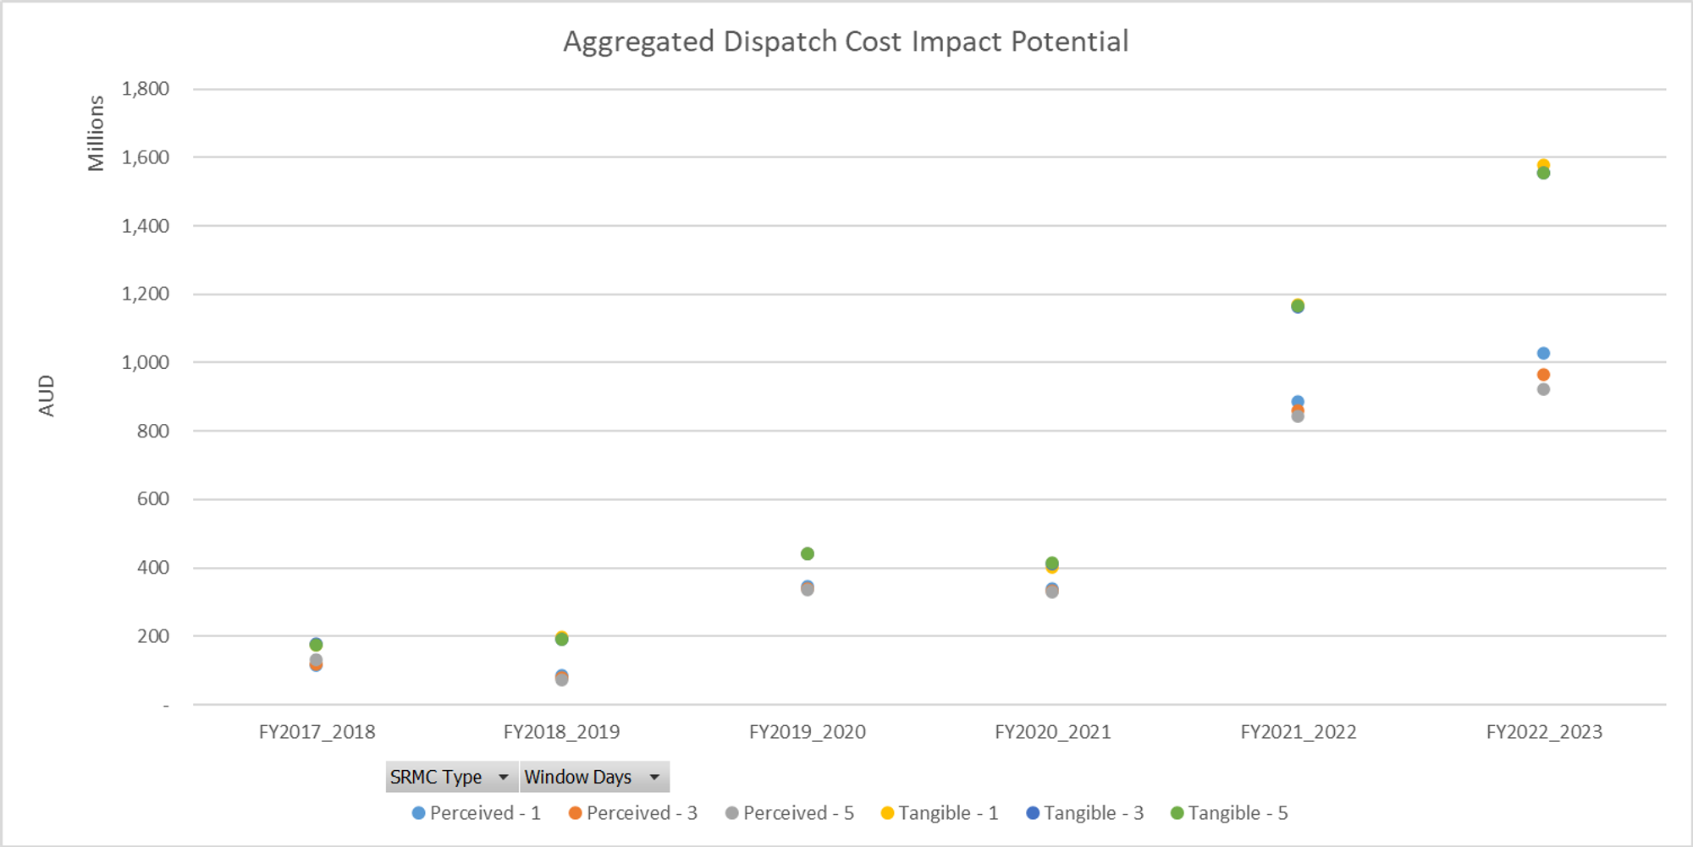
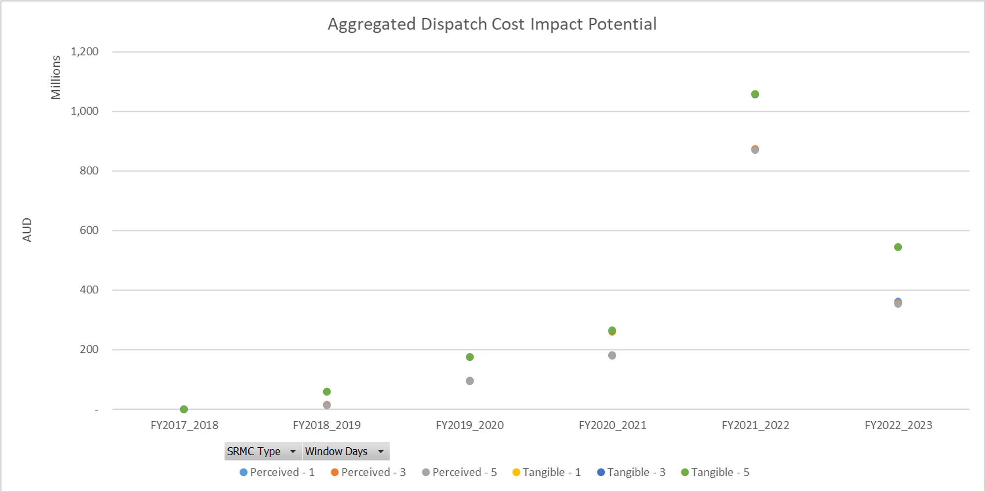
Regional individual potential market power
Hornsdale Power Reserve
Dalrymple North BESS
Key messages:
Comparing to other SA generators, major batteries like Hornsdale and Dalrymple North show evidences of trying exercising market power using their estimated tangible and perceived SRMC, especially in FY2021-2022 and FY 2022-2023.
This also shows while batteries only represent a small proportion of registered capacity, it has potentially to greatly impact dispatch results.

